Slide 1
Introduction to DjAngo
Rohan Patel

Slide 2
Topics to cover
Introduction
What is Web Application
What is API
What are Apps in Django
Django – MVC or MVT
Installing Django and PIPenv
Projects

Slide 3
Introduction
Django is a high-level Python framework. It is free, open-source and one of the most popular frameworks.
Django is popular among developers because of the vast amount to inbuilt features it provides such as admin interface, Object relational mapper for SQL and caching
Web Applications using Django – Netflix, YouTube, Uber, Spotify and NASA

Slide 4
Other Features of Django
Secure
Scalable
Rapid Development
Vast and Supported Community

Slide 5
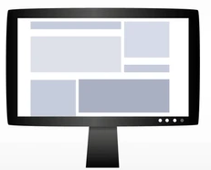
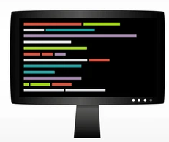
What is Web Application
In Basic Terms a web application is made up of two part a front end and a back end
Request
Response

Slide 6
Different types of Responses
HTML
JSON
File
Empty

Slide 7
What is API
API or Application Programming Interface can be thought of as a medium of communications between two applications.
Methods
GET
POST
PUT
DELETE

Slide 8
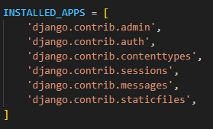
What are Apps in Django
Django project is just a collections of apps
Every app we create needs to be declared in settings.py file
python manage.py startapp home

Slide 9
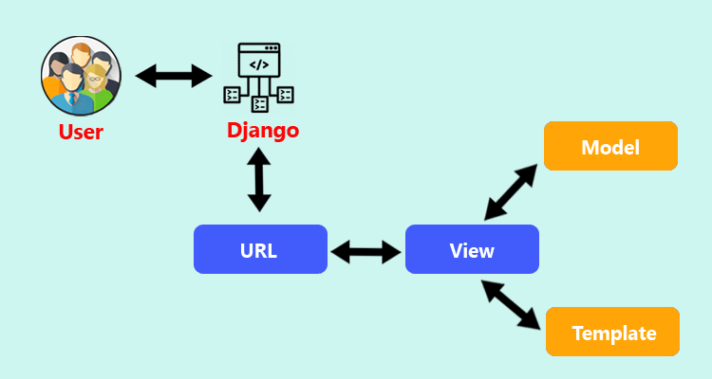
Django – MVC or MVT

Slide 10
Installing Django and PIPenv
PIPenv
pip install pipenv
Django
pipenv install django
django-admin startproject demo .
python manage.py runserver 6754

Slide 11
Projects

Slide 12
Thank You

